Slide 1
STATEMENT
BADM PROJECT
Netflix Analysis
PRESENTER NAME : SYED IBRAHIM M.COM., PGDCA., PGDED., CGT., (BUSINESS ANALYST AND DIGITAL MARKETING)
DATE : 30.06.2025

Slide 2
Insights
Content Consumption Dashboard Insights
Total Customers: 14,059
Total Movies Available: 7,103
Total TV Series Available: 6,921
Average Customer Rating: 3.00
Average Engagement Time per Customer Movies: 1 hour 47 minutes
TV Series: 13 hours 45 minutes (assumed)
Content Distribution Movies:
New Content: 43.84%
Old Content: 56.16%
TV Series:New Content: 43.91%
Old Content: 56.09%
Viewership Insights
Average Watchers per Movie: 28
Average Watchers per TV Series Season: 3
Top Engagement Ratings
Most Engaging Content Ratings:
PG, TV-Y7, and G
Genre-wise High Streaming Content
Comedy: Half Property – 409 hrs
Horror: Over Material – 364 hrs
Drama: Writer Down Fish – 330 hrs Documentary: Structure Two Require – 329 hrs Sci-Fi: Official Miss – 302 hrs
Viewer Type Analysis
Movies:
Repeated Viewers: 97.95%
One-time Viewers: 2.05%
TV Series:
Repeated Viewers: 72.80%
One-time Viewers: 27.20%
Popular Creators
Top Directors with High Fan-base:
James Smith, Crystal Taylor, David Smith
Top Casts with High Fan-base:
Steven Smith, Lisa Smith, Albert Weeks
Top Streaming Content
Movies: Player, Phone, Difficult Past
TV Shows: Half Property, Over Material, Threat

Slide 3




Customer Analysis
Customer Analysis

Slide 4
S/E ANALYSIS
Subscription and Engagement Analysis

Slide 5
1

Slide 6
1
Australia
OVERALL ANALYSIS
Engagement vs Rating Trend:
The scatter plot shows a negative slope.
Customer-given ratings are high for TV-Y7 and TV-PG content.
But these highly rated content pieces show low engagement (few views).
Regression results:R² > 0.7, Adjusted R² > 0.6 → indicates a strong inverse relationship between rating and view count.
Audience Behavior Insight
Dream_Code Teen (Male) customers in Australia appreciate safe, youth-friendly content, but they don’t consistently watch it.
There’s likely a disconnect between liking and actual viewing — possibly due to how content is presented or discovered.
Why this ? ✔️ DreamCode_Teen (R² > 0.7, valid Adjusted R²) should be treated as the primary valid segment. ❌ Segments with R² = 1 but Adjusted R² = NaN are statistically invalid due to low data and should be ignored in the analysis.
RECOMMENDATION
1. Enhance Visibility of High-Rated Content:
Promote TV-Y7 and TV-PG (preferred by males) and TV-14 (preferred by females) through:
Spotlight sections
“Top Rated by DreamCode_Teens in Australia” banners
Genre-based carousels for teen viewers
2. Use Targeted Micro-Campaigns:
Run short-form video promos on platforms teens actively use (YouTube, Instagram, Snapchat).
Tailor content:
Male focus: highlight funny, techy, or action hooks from TV-Y7 & TV-PG.
Female focus: promote dramatic or emotional moments from TV-14 content.
Use 15–30 second snackable clips rather than full trailers
Improve Content Packaging
Refresh:
Thumbnails (bright, high contrast, with characters or key emotion scenes)
Episode names (add curiosity or trend keywords)
Descriptions with hooks like “For fans of AI & animation” or “Teen rebellion meets tech”
Ensure alignment with current teen trends.

Slide 7
OVERALL ANALYSIS
Engagement vs Rating Trend:
The scatter plot shows a negative slope.
Customer-given ratings are high for TV-Y7 and TV-PG content.
But these highly rated content pieces show low engagement (few views).
Regression results:R² > 0.7, Adjusted R² > 0.6 → indicates a strong inverse relationship between rating and view count.
Audience Behavior Insight
Dream_Code Teen (Male) customers in Australia appreciate safe, youth-friendly content, but they don’t consistently watch it.
There’s likely a disconnect between liking and actual viewing — possibly due to how content is presented or discovered.
Why this ? ✔️ DreamCode_Teen (R² > 0.7, valid Adjusted R²) should be treated as the primary valid segment. ❌ Segments with R² = 1 but Adjusted R² = NaN are statistically invalid due to low data and should be ignored in the analysis.
1
Australia
RECOMMENDATION
1. Enhance Visibility of High-Rated Content:
Promote TV-Y7 and TV-PG (preferred by males) and TV-14 (preferred by females) through:
Spotlight sections
“Top Rated by DreamCode_Teens in Australia” banners
Genre-based carousels for teen viewers
2. Use Targeted Micro-Campaigns:
Run short-form video promos on platforms teens actively use (YouTube, Instagram, Snapchat).
Tailor content:
Male focus: highlight funny, techy, or action hooks from TV-Y7 & TV-PG.
Female focus: promote dramatic or emotional moments from TV-14 content.
Use 15–30 second snackable clips rather than full trailers
Improve Content Packaging
Refresh:
Thumbnails (bright, high contrast, with characters or key emotion scenes)
Episode names (add curiosity or trend keywords)
Descriptions with hooks like “For fans of AI & animation” or “Teen rebellion meets tech”
Ensure alignment with current teen trends.

Slide 8
2

Slide 9
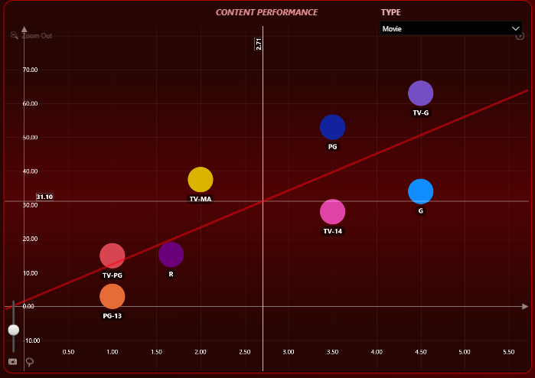
Target Segment is
Insight Core Adult (Female)
2
Movies
TV Show
France
ENGAGEMENT VS RATING TREND:
InsightCore_Adult(Female):-
Trend: Positive Slope
As watch duration increases, customer rating increases.
TV-G: High engagement & high rating → top performer.
PG-13 & R: Low engagement & low rating → underperforming.
Regression Fit: R² > 0.6, Adjusted R² > 0.5 → Reliable trend.
AUDIENCE BEHAVIOR ANALYSIS:-
InsightCore_Adult (Female):
Viewers rate content higher when engagement is deeper.
TV-PG and R rated movies have low current performance but show growth potential and need consistent exposure and improved positioning.
Why?
TV-PG & R → Low engagement, low rating ✅ These categories sit on the regression line, showing they follow the segment's positive engagement–rating pattern. 👉 This means they have potential, and with consistent exposure and improved packaging, both engagement and customer ratings can increase.
RECOMMENDATION
RECOMMENDATION
1. Promote TV-PG and R-rated content more actively through emotionally-driven banners, mature-themed thumbnails, and thoughtful teaser clips, as these categories follow the positive engagement–rating trend despite low current performance.
2. Increase the visibility of TV-PG and R content in curated carousels like “Stories That Stay” or “Real & Relatable,” as these genres have the potential to perform well with deeper viewer engagement.
3. Repackage TV-PG and R movies with emotionally resonant titles, realistic keywords, and appealing artwork to align better with adult female preferences and improve discovery and interest.
1. Enhance Visibility of High-Rated Content:
Promote TV-G (preferred by InsightCore_Adult), TV-PG (preferred by Laugh_Legacy), and TV-Y7 (preferred by LoveBloom_Teen) through:
Spotlight sections
“Top Rated by Viewers in France” banners
Segment-specific carousels like:
“Comfort Classics for Adults” (TV-G)
“Easy Watch Picks for Teens” (TV-Y7)
“Light Laughs for Legacy Viewers” (TV-PG)
Improve Content Packaging
Enhance visibility and relatability with:
Thumbnails: Clean, colorful, emotional expression or familiar characters
Episode names: Add curiosity and teen/family-relevant phrasing
Descriptions: Use hooks like:
“Warm stories for quiet nights” (TV-G)
“Relatable drama, low on stress” (TV-PG)
“Fun-first movies for every mood” (TV-Y7)
Ensure alignment with age group preferences and local culture.
2. Use Targeted Micro-Campaigns:
Run short-form promos on platforms popular in France:
YouTube Shorts, Instagram Reels, Snapchat
Female focus:
InsightCore_Adult → emotional, feel-good moments from TV-G
Laugh_Legacy → light comedy & slice-of-life hooks from TV-PG
Male focus:
LoveBloom_Teen → fun, animated, adventure-themed TV-Y7 scenes
Keep videos 15–30 seconds, optimized for mobile.

Slide 10
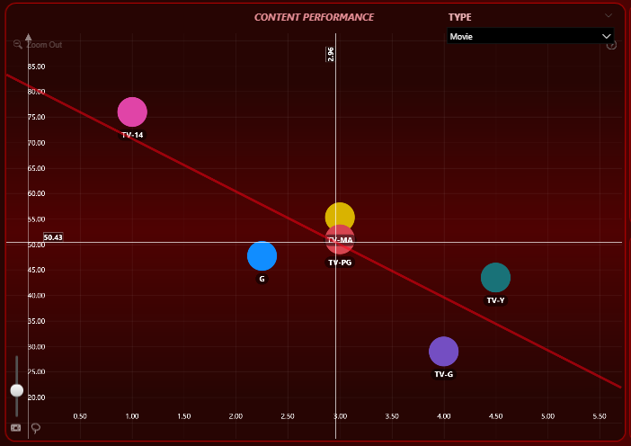
ENGAGEMENT VS RATING TREND:
InsightCore_Adult(Female):-
Trend: Positive Slope
As watch duration increases, customer rating increases.
TV-G: High engagement & high rating → top performer.
PG-13 & R: Low engagement & low rating → underperforming.
Regression Fit: R² > 0.6, Adjusted R² > 0.5 → Reliable trend.
AUDIENCE BEHAVIOR ANALYSIS:-
InsightCore_Adult (Female):
Viewers rate content higher when engagement is deeper.
TV-PG and R rated movies have low current performance but show growth potential and need consistent exposure and improved positioning.
Why?
TV-PG & R → Low engagement, low rating ✅ These categories sit on the regression line, showing they follow the segment's positive engagement–rating pattern. 👉 This means they have potential, and with consistent exposure and improved packaging, both engagement and customer ratings can increase.
Target Segment is
Insight Core Adult (Female)
2
Movies
TV Show
France
RECOMMENDATION
1. Promote TV-PG and R-rated content more actively through emotionally-driven banners, mature-themed thumbnails, and thoughtful teaser clips, as these categories follow the positive engagement–rating trend despite low current performance.
2. Increase the visibility of TV-PG and R content in curated carousels like “Stories That Stay” or “Real & Relatable,” as these genres have the potential to perform well with deeper viewer engagement.
3. Repackage TV-PG and R movies with emotionally resonant titles, realistic keywords, and appealing artwork to align better with adult female preferences and improve discovery and interest.
Target Segment is
Laugh Legacy (Female)
RECOMMENDATION
Why?
TV-14 → High engagement, low rating ❌ Viewers are initially attracted to bold or intense themes but feel emotionally disconnected, leading to poor satisfaction.
TV-PG → Moderate engagement, moderate rating ✅ Consistently aligns better with the audience’s comfort zone and emotional needs, showing potential for stronger connection with improved storytelling and presentation.
1. Enhance Visibility of High-Rated Content:
Promote TV-G (preferred by InsightCore_Adult), TV-PG (preferred by Laugh_Legacy), and TV-Y7 (preferred by LoveBloom_Teen) through:
Spotlight sections
“Top Rated by Viewers in France” banners
Segment-specific carousels like:
“Comfort Classics for Adults” (TV-G)
“Easy Watch Picks for Teens” (TV-Y7)
“Light Laughs for Legacy Viewers” (TV-PG)
Improve Content Packaging
Enhance visibility and relatability with:
Thumbnails: Clean, colorful, emotional expression or familiar characters
Episode names: Add curiosity and teen/family-relevant phrasing
Descriptions: Use hooks like:
“Warm stories for quiet nights” (TV-G)
“Relatable drama, low on stress” (TV-PG)
“Fun-first movies for every mood” (TV-Y7)
Ensure alignment with age group preferences and local culture.
2. Use Targeted Micro-Campaigns:
Run short-form promos on platforms popular in France:
YouTube Shorts, Instagram Reels, Snapchat
Female focus:
InsightCore_Adult → emotional, feel-good moments from TV-G
Laugh_Legacy → light comedy & slice-of-life hooks from TV-PG
Male focus:
LoveBloom_Teen → fun, animated, adventure-themed TV-Y7 scenes
Keep videos 15–30 seconds, optimized for mobile.
ENGAGEMENT VS RATING TREND:
Laugh Legacy(Female):-
Trend: Negative Correlation:
As engagement increases, customer satisfaction (rating) decreases.
TV-14: High engagement but low satisfaction → draws attention but fails to meet expectations.
TV-PG: Moderate engagement and moderate satisfaction → relatively balanced.
Regression Fit:
R² > 0.7, Adjusted R² > 0.6 → Statistically strong negative relationship.
AUDIENCE BEHAVIOR ANALYSIS:-
The scatter plot shows that TV-14 content has high engagement but low customer rating, indicating viewers are drawn in but leave unsatisfied. TV-PG content shows moderate engagement and moderate ratings, reflecting better alignment with viewer preferences. This suggests the segment prefers balanced, emotionally satisfying content like TV-PG, while bold themes in TV-14 fail to deliver the expected payoff.

Slide 11
Target Segment is
Insight Core Adult (Female)
RECOMMENDATION
1. Promote TV-PG and R-rated content more actively through emotionally-driven banners, mature-themed thumbnails, and thoughtful teaser clips, as these categories follow the positive engagement–rating trend despite low current performance.
2. Increase the visibility of TV-PG and R content in curated carousels like “Stories That Stay” or “Real & Relatable,” as these genres have the potential to perform well with deeper viewer engagement.
3. Repackage TV-PG and R movies with emotionally resonant titles, realistic keywords, and appealing artwork to align better with adult female preferences and improve discovery and interest.
Target Segment is
Laugh Legacy (Female)
2
Movies
TV Show
Why?
TV-14 → High engagement, low rating ❌ Viewers are initially attracted to bold or intense themes but feel emotionally disconnected, leading to poor satisfaction.
TV-PG → Moderate engagement, moderate rating ✅ Consistently aligns better with the audience’s comfort zone and emotional needs, showing potential for stronger connection with improved storytelling and presentation.
France
ENGAGEMENT VS RATING TREND:
Laugh Legacy(Female):-
Trend: Negative Correlation:
As engagement increases, customer satisfaction (rating) decreases.
TV-14: High engagement but low satisfaction → draws attention but fails to meet expectations.
TV-PG: Moderate engagement and moderate satisfaction → relatively balanced.
Regression Fit:
R² > 0.7, Adjusted R² > 0.6 → Statistically strong negative relationship.
AUDIENCE BEHAVIOR ANALYSIS:-
The scatter plot shows that TV-14 content has high engagement but low customer rating, indicating viewers are drawn in but leave unsatisfied. TV-PG content shows moderate engagement and moderate ratings, reflecting better alignment with viewer preferences. This suggests the segment prefers balanced, emotionally satisfying content like TV-PG, while bold themes in TV-14 fail to deliver the expected payoff.
RECOMMENDATION
1. Reduce emphasis on TV-14 content in prominent placements, as it attracts attention but fails to meet emotional expectations, leading to low customer satisfaction.
2. Promote TV-PG content more actively using light-hearted, relatable thumbnails and positive messaging banners that better reflect the audience’s emotional preferences.
3. Repackage TV-PG series with uplifting titles, gentle humor, and everyday story themes to enhance relatability and viewer connection.

Slide 12
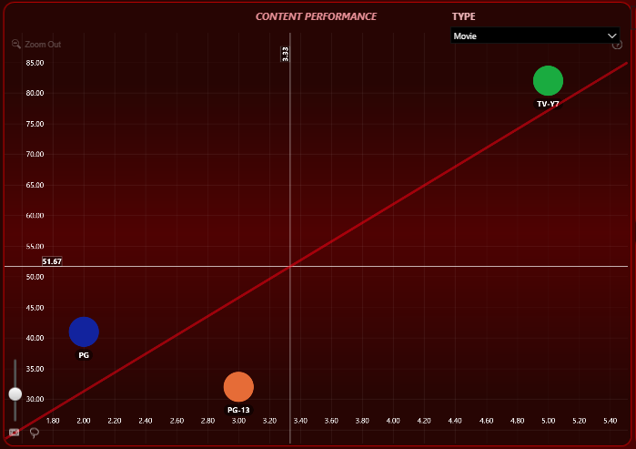
Why?
TV-14 → High engagement, low rating ❌ Viewers are initially attracted to bold or intense themes but feel emotionally disconnected, leading to poor satisfaction.
TV-PG → Moderate engagement, moderate rating ✅ Consistently aligns better with the audience’s comfort zone and emotional needs, showing potential for stronger connection with improved storytelling and presentation.
ENGAGEMENT VS RATING TREND:
Laugh Legacy(Female):-
Trend: Negative Correlation:
As engagement increases, customer satisfaction (rating) decreases.
TV-14: High engagement but low satisfaction → draws attention but fails to meet expectations.
TV-PG: Moderate engagement and moderate satisfaction → relatively balanced.
Regression Fit:
R² > 0.7, Adjusted R² > 0.6 → Statistically strong negative relationship.
AUDIENCE BEHAVIOR ANALYSIS:-
The scatter plot shows that TV-14 content has high engagement but low customer rating, indicating viewers are drawn in but leave unsatisfied. TV-PG content shows moderate engagement and moderate ratings, reflecting better alignment with viewer preferences. This suggests the segment prefers balanced, emotionally satisfying content like TV-PG, while bold themes in TV-14 fail to deliver the expected payoff.
Target Segment is
Laugh Legacy (Female)
2
Movies
TV Show
France
RECOMMENDATION
1. Reduce emphasis on TV-14 content in prominent placements, as it attracts attention but fails to meet emotional expectations, leading to low customer satisfaction.
2. Promote TV-PG content more actively using light-hearted, relatable thumbnails and positive messaging banners that better reflect the audience’s emotional preferences.
3. Repackage TV-PG series with uplifting titles, gentle humor, and everyday story themes to enhance relatability and viewer connection.
Target Segment is
Love Bloom Teen (Male)
Why?
TV-Y7 → High engagement, high rating ✅ Viewers are highly satisfied with fun, fast-paced, and visually engaging content, indicating strong alignment with their preferences.
This segment responds well to content that is light, accessible, and entertaining, showing a clear connection between active viewing and satisfaction.
ENGAGEMENT VS RATING TREND:
LoveBloom_Teen(Male):-
Trend: Positive Slope
High engagement results in high customer ratings.
TV-Y7: High rating and high engagement → best aligned.
Regression Fit: R² > 0.7, Adjusted R² > 0.5 → Very strong trend.
AUDIENCE BEHAVIOR ANALYSIS:-
Shows a strong link between high engagement and high customer rating.
TV-Y7 content aligns perfectly with their preferences – fun, light, and teen-friendly.
They are responsive to content that is visually engaging, fast-paced, and easy to consume

Slide 13
Target Segment is
Laugh Legacy (Female)
RECOMMENDATION
1. Reduce emphasis on TV-14 content in prominent placements, as it attracts attention but fails to meet emotional expectations, leading to low customer satisfaction.
2. Promote TV-PG content more actively using light-hearted, relatable thumbnails and positive messaging banners that better reflect the audience’s emotional preferences.
3. Repackage TV-PG series with uplifting titles, gentle humor, and everyday story themes to enhance relatability and viewer connection.
Target Segment is
Love Bloom Teen (Male)
2
Movies
TV Show
Why?
TV-Y7 → High engagement, high rating ✅ Viewers are highly satisfied with fun, fast-paced, and visually engaging content, indicating strong alignment with their preferences.
This segment responds well to content that is light, accessible, and entertaining, showing a clear connection between active viewing and satisfaction.
France
ENGAGEMENT VS RATING TREND:
LoveBloom_Teen(Male):-
Trend: Positive Slope
High engagement results in high customer ratings.
TV-Y7: High rating and high engagement → best aligned.
Regression Fit: R² > 0.7, Adjusted R² > 0.5 → Very strong trend.
AUDIENCE BEHAVIOR ANALYSIS:-
Shows a strong link between high engagement and high customer rating.
TV-Y7 content aligns perfectly with their preferences – fun, light, and teen-friendly.
They are responsive to content that is visually engaging, fast-paced, and easy to consume
RECOMMENDATION
1. Promote TV-Y7 content prominently through energetic banners, animated thumbnails, and fast-cut teasers that highlight humor, action, and visual excitement.
2. Curate themed playlists like “Quick Laughs,” “Teen Fun Picks,” or “Fast & Fun TV” to match the segment’s preference for light, easily consumable content.
3. Optimize for mobile-first viewing with vertical trailers and bite-sized previews tailored for short attention spans and fast engagement.
4. Maintain momentum with regular content refreshes and push notifications when new TV-Y7 episodes drop to sustain active engagement and loyalty.

Slide 14
Why?
TV-Y7 → High engagement, high rating ✅ Viewers are highly satisfied with fun, fast-paced, and visually engaging content, indicating strong alignment with their preferences.
This segment responds well to content that is light, accessible, and entertaining, showing a clear connection between active viewing and satisfaction.
ENGAGEMENT VS RATING TREND:
LoveBloom_Teen(Male):-
Trend: Positive Slope
High engagement results in high customer ratings.
TV-Y7: High rating and high engagement → best aligned.
Regression Fit: R² > 0.7, Adjusted R² > 0.5 → Very strong trend.
AUDIENCE BEHAVIOR ANALYSIS:-
Shows a strong link between high engagement and high customer rating.
TV-Y7 content aligns perfectly with their preferences – fun, light, and teen-friendly.
They are responsive to content that is visually engaging, fast-paced, and easy to consume
Target Segment is
Love Bloom Teen (Male)
2
Movies
TV Show
France
RECOMMENDATION
1. Promote TV-Y7 content prominently through energetic banners, animated thumbnails, and fast-cut teasers that highlight humor, action, and visual excitement.
2. Curate themed playlists like “Quick Laughs,” “Teen Fun Picks,” or “Fast & Fun TV” to match the segment’s preference for light, easily consumable content.
3. Optimize for mobile-first viewing with vertical trailers and bite-sized previews tailored for short attention spans and fast engagement.
4. Maintain momentum with regular content refreshes and push notifications when new TV-Y7 episodes drop to sustain active engagement and loyalty.
Target Segment is
Smiley Stream Youth (Female)
Why?
PG-13 → Low engagement, but high customer rating ✅ Viewers appreciate the content quality — it just needs better visibility and promotion.
TV-Y7 → High engagement, but low satisfaction ❌ Viewers are watching, but not enjoying — possibly due to lack of depth or relatability.
ENGAGEMENT VS RATING TREND:
Scatter plot shows a negative slope: As engagement decreases, customer rating increases.
PG-13 appears on the regression line:
Low engagement, but high customer rating
TV-Y7 also lies on the regression line:
High engagement, but low customer rating
Regression strength:
R² = 0.6, Adjusted R² = 0.5 → moderately reliable trend.
AUDIENCE BEHAVIOR ANALYSIS:-
Simley Stream Youth (Female): viewers prefer mature, story-driven TV series over light or overly child-friendly content.
PG-13 has high potential — it just needs better discovery, packaging, or placement.

Slide 15
Target Segment is
Love Bloom Teen (Male)
RECOMMENDATION
1. Promote TV-Y7 content prominently through energetic banners, animated thumbnails, and fast-cut teasers that highlight humor, action, and visual excitement.
2. Curate themed playlists like “Quick Laughs,” “Teen Fun Picks,” or “Fast & Fun TV” to match the segment’s preference for light, easily consumable content.
3. Optimize for mobile-first viewing with vertical trailers and bite-sized previews tailored for short attention spans and fast engagement.
4. Maintain momentum with regular content refreshes and push notifications when new TV-Y7 episodes drop to sustain active engagement and loyalty.
Target Segment is
Smiley Stream Youth (Female)
2
Movies
TV Show
Why?
PG-13 → Low engagement, but high customer rating ✅ Viewers appreciate the content quality — it just needs better visibility and promotion.
TV-Y7 → High engagement, but low satisfaction ❌ Viewers are watching, but not enjoying — possibly due to lack of depth or relatability.
France
ENGAGEMENT VS RATING TREND:
Scatter plot shows a negative slope: As engagement decreases, customer rating increases.
PG-13 appears on the regression line:
Low engagement, but high customer rating
TV-Y7 also lies on the regression line:
High engagement, but low customer rating
Regression strength:
R² = 0.6, Adjusted R² = 0.5 → moderately reliable trend.
AUDIENCE BEHAVIOR ANALYSIS:-
Simley Stream Youth (Female): viewers prefer mature, story-driven TV series over light or overly child-friendly content.
PG-13 has high potential — it just needs better discovery, packaging, or placement.
RECOMMENDATION
1. Promote PG-13 content more actively through youth-focused banners, dramatic thumbnails, and short emotional teaser clips, as this content is highly rated by the Simley Stream Youth (Female) segment despite currently low engagement.
2. Reduce the visibility of TV-Y7 content on screens for this segment, since it shows high engagement but consistently receives low customer ratings, indicating a mismatch between viewership and satisfaction.
3. Repackage PG-13 series with more relatable titles, trend-based keywords, and appealing artwork to increase discoverability and connection with youth preferences

Slide 16
Target Segment is
Love Bloom Teen (Male)
RECOMMENDATION
1. Promote TV-Y7 content prominently through energetic banners, animated thumbnails, and fast-cut teasers that highlight humor, action, and visual excitement.
2. Curate themed playlists like “Quick Laughs,” “Teen Fun Picks,” or “Fast & Fun TV” to match the segment’s preference for light, easily consumable content.
3. Optimize for mobile-first viewing with vertical trailers and bite-sized previews tailored for short attention spans and fast engagement.
4. Maintain momentum with regular content refreshes and push notifications when new TV-Y7 episodes drop to sustain active engagement and loyalty.
Target Segment is
Smiley Stream Youth (Female)
2
Movies
TV Show
France
RECOMMENDATION
1. Promote PG-13 content more actively through youth-focused banners, dramatic thumbnails, and short emotional teaser clips, as this content is highly rated by the Simley Stream Youth (Female) segment despite currently low engagement.
2. Reduce the visibility of TV-Y7 content on screens for this segment, since it shows high engagement but consistently receives low customer ratings, indicating a mismatch between viewership and satisfaction.
3. Repackage PG-13 series with more relatable titles, trend-based keywords, and appealing artwork to increase discoverability and connection with youth preferences

Slide 17
3

Slide 18
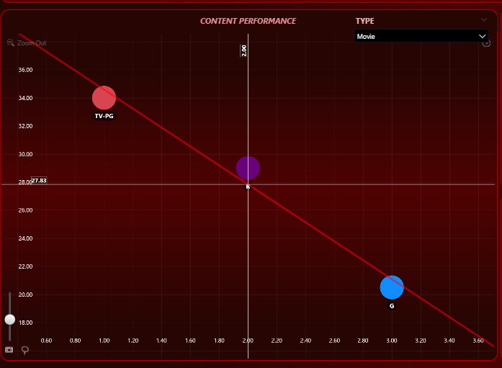
Target Segment is
Love Bloom Teen (Female)
3
Movies
TV Show
Why?
1. G-rated: Low engagement but high satisfaction ✅ → Customers choose it less often, but when they do, they love it.
2. TV-PG: High engagement, low satisfaction ❌ → Likely being pushed or misaligned with segment’s values
3. R-rated: Moderate everything ➖ → No strong appeal; not worth focusing on
India
ENGAGEMENT VS RATING TREND:
Love Bloom Teen (Female) – India Trend: Negative slope → Higher engagement tends to result in lower customer ratings. Fit Quality: R² = 0.97, Adjusted R² = 0.95 → Extremely strong and reliable trend
Insight on G Rated Content:
Despite low engagement, it lies above the regression line → High customer satisfaction
G-rated movies are well-aligned with viewer expectations and emotional preferences
AUDIENCE BEHAVIOR ANALYSIS:-
There is a clear inverse relationship: when engagement is artificially increased (e.g., due to platform promotion), it doesn’t guarantee high customer satisfaction.
G-rated content receives the highest ratings despite having low engagement → Reflects genuine liking and emotional connection
TV-PG content, although heavily consumed, is rated poorly, showing dissatisfaction
R-rated movies receive moderate ratings and moderate engagement → Less preferred.
RECOMMENDATION
1. Prioritize G-rated content for this segment — even with low watch rates, it results in very high satisfaction. Promote through trust-based, emotion-driven banners.
2. Reduce recommendation of TV-PG movies, as high engagement is misleading and leads to dissatisfaction. This segment does not emotionally connect with it.
3. Avoid pushing R-rated content, as it receives average interest and average satisfaction — not impactful for this segment.
4. Refine the algorithm to recommend quality-focused content, not engagement-heavy titles. Maintain emotional and light-hearted themes suitable for teen females.

Slide 19
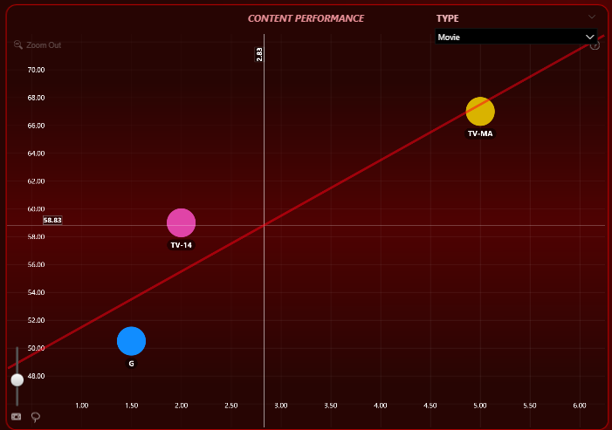
Why?
1. G-rated: Low engagement but high satisfaction ✅ → Customers choose it less often, but when they do, they love it.
2. TV-PG: High engagement, low satisfaction ❌ → Likely being pushed or misaligned with segment’s values
3. R-rated: Moderate everything ➖ → No strong appeal; not worth focusing on
ENGAGEMENT VS RATING TREND:
Love Bloom Teen (Female) – India Trend: Negative slope → Higher engagement tends to result in lower customer ratings. Fit Quality: R² = 0.97, Adjusted R² = 0.95 → Extremely strong and reliable trend
Insight on G Rated Content:
Despite low engagement, it lies above the regression line → High customer satisfaction
G-rated movies are well-aligned with viewer expectations and emotional preferences
AUDIENCE BEHAVIOR ANALYSIS:-
There is a clear inverse relationship: when engagement is artificially increased (e.g., due to platform promotion), it doesn’t guarantee high customer satisfaction.
G-rated content receives the highest ratings despite having low engagement → Reflects genuine liking and emotional connection
TV-PG content, although heavily consumed, is rated poorly, showing dissatisfaction
R-rated movies receive moderate ratings and moderate engagement → Less preferred.
Target Segment is
Love Bloom Teen (Female)
3
Movies
TV Show
India
RECOMMENDATION
1. Prioritize G-rated content for this segment — even with low watch rates, it results in very high satisfaction. Promote through trust-based, emotion-driven banners.
2. Reduce recommendation of TV-PG movies, as high engagement is misleading and leads to dissatisfaction. This segment does not emotionally connect with it.
3. Avoid pushing R-rated content, as it receives average interest and average satisfaction — not impactful for this segment.
4. Refine the algorithm to recommend quality-focused content, not engagement-heavy titles. Maintain emotional and light-hearted themes suitable for teen females.
Target Segment is
ThrillZest Teen (Female)
Why?
1. TV-MA: High engagement & high rating ✅ → Indicates viewers are deeply satisfied with intense, mature themes and adult content.
2. TV-14: Moderate engagement & rating → Could improve with better promotion and positioning.
3. G-rated: Low engagement & rating ❌ → Indicates mismatch between content tone and audience maturity level. Likely perceived as childish.
ENGAGEMENT VS RATING TREND:
Thrill Zest Teen (Female) – India Trend: Positive slope → Higher engagement generally leads to higher customer ratings. Fit Quality:
R² = 0.8
Adjusted R² = 0.6 → Strong and moderately reliable trend.
Insight on TV-MA Content:
Frequently appears above the regression line.
Highest engagement and highest rating → Top performer.
AUDIENCE BEHAVIOR ANALYSIS:-
Strong correlation between engagement and customer satisfaction.
TV-MA movies perfectly match this segment’s entertainment preference—likely due to mature, thrilling themes.
TV-14 movies show moderate engagement and decent ratings—slightly under the line but have visible potential.
G-rated movies fall significantly below the regression line—low engagement and poor satisfaction.

Slide 20
Target Segment is
Love Bloom Teen (Female)
RECOMMENDATION
1. Prioritize G-rated content for this segment — even with low watch rates, it results in very high satisfaction. Promote through trust-based, emotion-driven banners.
2. Reduce recommendation of TV-PG movies, as high engagement is misleading and leads to dissatisfaction. This segment does not emotionally connect with it.
3. Avoid pushing R-rated content, as it receives average interest and average satisfaction — not impactful for this segment.
4. Refine the algorithm to recommend quality-focused content, not engagement-heavy titles. Maintain emotional and light-hearted themes suitable for teen females.
Target Segment is
ThrillZest Teen (Female)
3
Movies
TV Show
Why?
1. TV-MA: High engagement & high rating ✅ → Indicates viewers are deeply satisfied with intense, mature themes and adult content.
2. TV-14: Moderate engagement & rating → Could improve with better promotion and positioning.
3. G-rated: Low engagement & rating ❌ → Indicates mismatch between content tone and audience maturity level. Likely perceived as childish.
India
ENGAGEMENT VS RATING TREND:
Thrill Zest Teen (Female) – India Trend: Positive slope → Higher engagement generally leads to higher customer ratings. Fit Quality:
R² = 0.8
Adjusted R² = 0.6 → Strong and moderately reliable trend.
Insight on TV-MA Content:
Frequently appears above the regression line.
Highest engagement and highest rating → Top performer.
AUDIENCE BEHAVIOR ANALYSIS:-
Strong correlation between engagement and customer satisfaction.
TV-MA movies perfectly match this segment’s entertainment preference—likely due to mature, thrilling themes.
TV-14 movies show moderate engagement and decent ratings—slightly under the line but have visible potential.
G-rated movies fall significantly below the regression line—low engagement and poor satisfaction.
RECOMMENDATION
1. Boost TV-MA movie recommendations through thriller-based carousels, bold thumbnails, and genre-specific collections — this is the strongest performing category for this segment.
2. Push TV-14 content using targeted nudges, promotional banners, and in-app notifications; potential to improve if more visibility and excitement are built.
3. Stop recommending G-rated movies to this segment — consistently low engagement and low satisfaction may lead to overall user churn or dissatisfaction.

Slide 21
Why?
1. TV-MA: High engagement & high rating ✅ → Indicates viewers are deeply satisfied with intense, mature themes and adult content.
2. TV-14: Moderate engagement & rating → Could improve with better promotion and positioning.
3. G-rated: Low engagement & rating ❌ → Indicates mismatch between content tone and audience maturity level. Likely perceived as childish.
ENGAGEMENT VS RATING TREND:
Thrill Zest Teen (Female) – India Trend: Positive slope → Higher engagement generally leads to higher customer ratings. Fit Quality:
R² = 0.8
Adjusted R² = 0.6 → Strong and moderately reliable trend.
Insight on TV-MA Content:
Frequently appears above the regression line.
Highest engagement and highest rating → Top performer.
AUDIENCE BEHAVIOR ANALYSIS:-
Strong correlation between engagement and customer satisfaction.
TV-MA movies perfectly match this segment’s entertainment preference—likely due to mature, thrilling themes.
TV-14 movies show moderate engagement and decent ratings—slightly under the line but have visible potential.
G-rated movies fall significantly below the regression line—low engagement and poor satisfaction.
Target Segment is
ThrillZest Teen (Female)
3
Movies
TV Show
India
RECOMMENDATION
1. Boost TV-MA movie recommendations through thriller-based carousels, bold thumbnails, and genre-specific collections — this is the strongest performing category for this segment.
2. Push TV-14 content using targeted nudges, promotional banners, and in-app notifications; potential to improve if more visibility and excitement are built.
3. Stop recommending G-rated movies to this segment — consistently low engagement and low satisfaction may lead to overall user churn or dissatisfaction.
Target Segment is
Male & Female
ENGAGEMENT VS RATING TREND:
India – TV Shows (Male & Female) Trend: No clear pattern Fit Quality:
R² < 0.5 → Weak trend
Adjusted R² < 0.3 → Poor reliability
AUDIENCE BEHAVIOR ANALYSIS:-
In India, there's no consistent link between engagement and satisfaction for TV shows across genders.
Viewer preferences appear random or content-specific, not based on gender.
RECOMMENDATION:
1. Avoid gender-based targeting for TV shows in India — not effective in this region.
2. Use genre, theme, or behavior-based personalization instead.
3. Apply micro-segment strategies like “Weekend Bingers” or “Comedy Seekers” for better targeting.

Slide 22
Why?
1. TV-MA: High engagement & high rating ✅ → Indicates viewers are deeply satisfied with intense, mature themes and adult content.
2. TV-14: Moderate engagement & rating → Could improve with better promotion and positioning.
3. G-rated: Low engagement & rating ❌ → Indicates mismatch between content tone and audience maturity level. Likely perceived as childish.
Target Segment is
ThrillZest Teen (Female)
ENGAGEMENT VS RATING TREND:
Thrill Zest Teen (Female) – India Trend: Positive slope → Higher engagement generally leads to higher customer ratings. Fit Quality:
R² = 0.8
Adjusted R² = 0.6 → Strong and moderately reliable trend.
Insight on TV-MA Content:
Frequently appears above the regression line.
Highest engagement and highest rating → Top performer.
RECOMMENDATION
1. Boost TV-MA movie recommendations through thriller-based carousels, bold thumbnails, and genre-specific collections — this is the strongest performing category for this segment.
2. Push TV-14 content using targeted nudges, promotional banners, and in-app notifications; potential to improve if more visibility and excitement are built.
3. Stop recommending G-rated movies to this segment — consistently low engagement and low satisfaction may lead to overall user churn or dissatisfaction.
AUDIENCE BEHAVIOR ANALYSIS:-
Strong correlation between engagement and customer satisfaction.
TV-MA movies perfectly match this segment’s entertainment preference—likely due to mature, thrilling themes.
TV-14 movies show moderate engagement and decent ratings—slightly under the line but have visible potential.
G-rated movies fall significantly below the regression line—low engagement and poor satisfaction.
Target Segment is
Male & Female
3
Movies
TV Show
India
ENGAGEMENT VS RATING TREND:
India – TV Shows (Male & Female) Trend: No clear pattern Fit Quality:
R² < 0.5 → Weak trend
Adjusted R² < 0.3 → Poor reliability
AUDIENCE BEHAVIOR ANALYSIS:-
In India, there's no consistent link between engagement and satisfaction for TV shows across genders.
Viewer preferences appear random or content-specific, not based on gender.
RECOMMENDATION:
1. Avoid gender-based targeting for TV shows in India — not effective in this region.
2. Use genre, theme, or behavior-based personalization instead.
3. Apply micro-segment strategies like “Weekend Bingers” or “Comedy Seekers” for better targeting.

Slide 23
4

Slide 24
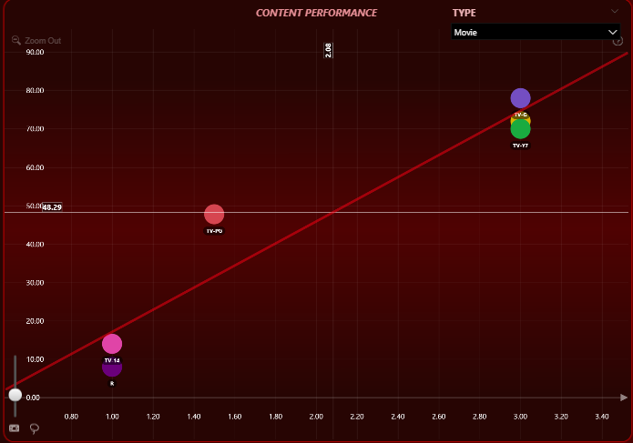
Target Segment is
Heart Stream Youth (Male)
4
Movies
TV Show
Why?
1. Viewers in this segment associate value with engagement
2. Accurate recommendations improve satisfaction
3. TV-14 is under-watched but has aligned characteristics → needs push
Japan
ENGAGEMENT VS RATING TREND:
Heart Stream Youth (Male) – Japan Trend: Positive slope → Higher engagement leads to higher ratings Fit Quality:
R² = 0.91, Adjusted R² = 0.89 → Very strong and reliable model fit
Insight on Key Content:
TV-Y7, TV-G, TV-MA: Appear on the regression line → High engagement & high satisfaction
TV-14: Low engagement & rating, but aligned with the trend → Potential for improvement
AUDIENCE BEHAVIOR ANALYSIS:-
This segment shows a clear behavioral pattern: the more engaged they are, the more they reward with high ratings.
TV-Y7, TV-G, TV-MA perfectly match expectations → Strong performers
TV-14 is not yet popular, but since it's on the regression line, it has room to grow with better exposure
RECOMMENDATION
1. Continue promoting TV-Y7, TV-G, and TV-MA — they drive both engagement and high customer ratings.
2. Gradually push TV-14 using smart recommendations, trending badges, and youth-focused promotions to unlock its growth potential.
3. Avoid overpromoting any content off the regression line to maintain trust and satisfaction in algorithmic recommendations.

Slide 25
Why?
1. Viewers in this segment associate value with engagement
2. Accurate recommendations improve satisfaction
3. TV-14 is under-watched but has aligned characteristics → needs push
ENGAGEMENT VS RATING TREND:
Heart Stream Youth (Male) – Japan Trend: Positive slope → Higher engagement leads to higher ratings Fit Quality:
R² = 0.91, Adjusted R² = 0.89 → Very strong and reliable model fit
Insight on Key Content:
TV-Y7, TV-G, TV-MA: Appear on the regression line → High engagement & high satisfaction
TV-14: Low engagement & rating, but aligned with the trend → Potential for improvement
AUDIENCE BEHAVIOR ANALYSIS:-
This segment shows a clear behavioral pattern: the more engaged they are, the more they reward with high ratings.
TV-Y7, TV-G, TV-MA perfectly match expectations → Strong performers
TV-14 is not yet popular, but since it's on the regression line, it has room to grow with better exposure
Target Segment is
Heart Stream Youth (Male)
4
Movies
TV Show
Japan
RECOMMENDATION
1. Continue promoting TV-Y7, TV-G, and TV-MA — they drive both engagement and high customer ratings.
2. Gradually push TV-14 using smart recommendations, trending badges, and youth-focused promotions to unlock its growth potential.
3. Avoid overpromoting any content off the regression line to maintain trust and satisfaction in algorithmic recommendations.

Slide 26
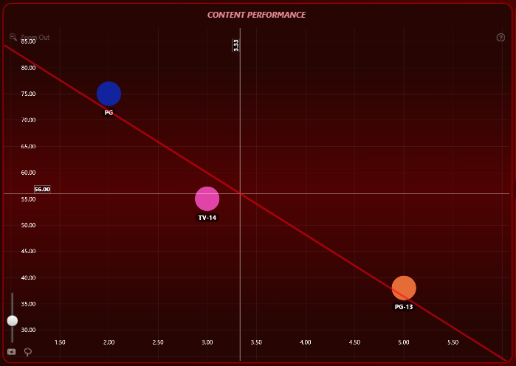
Target Segment is
Heart Stream Youth (Male)
RECOMMENDATION
1. Continue promoting TV-Y7, TV-G, and TV-MA — they drive both engagement and high customer ratings.
2. Gradually push TV-14 using smart recommendations, trending badges, and youth-focused promotions to unlock its growth potential.
3. Avoid overpromoting any content off the regression line to maintain trust and satisfaction in algorithmic recommendations.
Target Segment is
Love Bloom Teen (Male)
4
Movies
TV Show
Why?
1. Viewers in this group value meaningful or emotionally resonant content (PG-13)
2. PG content may be perceived as too light or immature for their taste
3. TV-14 aligns with trend and can rise with strategic push
Japan
ENGAGEMENT VS RATING TREND:
Love Bloom Teen (Male) – Japan Trend: Negative slope → Higher engagement does not lead to higher ratings Fit Quality:
R² = 0.94, Adjusted R² = 0.88 reliable (no outliers off pattern)
Insight on Key Content:
PG-13: Appears on regression line → Low engagement but high rating
PG: High engagement, low rating → Poor content experience
TV-14: Moderate engagement and rating, near regression line → Potential to grow
AUDIENCE BEHAVIOR ANALYSIS:-
This segment prefers quality over quantity — they rate content based on its appeal, not how much they watch.
PG-13 content is highly appreciated despite fewer views
PG content is being consumed, but viewers are not satisfied
TV-14 shows average performance but can be improved with proper positioning
RECOMMENDATION
1. Prioritize PG-13 rated content — it resonates well with this audience, even with lower engagement
2. Reduce promotion of PG-rated movies, as they fail to meet satisfaction levels
3. Explore TV-14 content through curated collections or themed playlists to grow engagement and ratings together
4. Avoid forcing engagement-heavy content that doesn’t align with quality expectations
RECOMMENDATION
1. Continue promoting TV-Y7, TV-G, and TV-MA — they drive both engagement and high customer ratings.
2. Gradually push TV-14 using smart recommendations, trending badges, and youth-focused promotions to unlock its growth potential.
3. Avoid overpromoting any content off the regression line to maintain trust and satisfaction in algorithmic recommendations.

Slide 27
Why?
1. Viewers in this segment associate value with engagement
2. Accurate recommendations improve satisfaction
3. TV-14 is under-watched but has aligned characteristics → needs push
Why?
1. Viewers in this group value meaningful or emotionally resonant content (PG-13)
2. PG content may be perceived as too light or immature for their taste
3. TV-14 aligns with trend and can rise with strategic push
ENGAGEMENT VS RATING TREND:
Heart Stream Youth (Male) – Japan Trend: Positive slope → Higher engagement leads to higher ratings Fit Quality:
R² = 0.91, Adjusted R² = 0.89 → Very strong and reliable model fit
Insight on Key Content:
TV-Y7, TV-G, TV-MA: Appear on the regression line → High engagement & high satisfaction
TV-14: Low engagement & rating, but aligned with the trend → Potential for improvement
ENGAGEMENT VS RATING TREND:
Love Bloom Teen (Male) – Japan Trend: Negative slope → Higher engagement does not lead to higher ratings Fit Quality:
R² = 0.94, Adjusted R² = 0.88 reliable (no outliers off pattern)
Insight on Key Content:
PG-13: Appears on regression line → Low engagement but high rating
PG: High engagement, low rating → Poor content experience
TV-14: Moderate engagement and rating, near regression line → Potential to grow
AUDIENCE BEHAVIOR ANALYSIS:-
This segment shows a clear behavioral pattern: the more engaged they are, the more they reward with high ratings.
TV-Y7, TV-G, TV-MA perfectly match expectations → Strong performers
TV-14 is not yet popular, but since it's on the regression line, it has room to grow with better exposure
AUDIENCE BEHAVIOR ANALYSIS:-
This segment prefers quality over quantity — they rate content based on its appeal, not how much they watch.
PG-13 content is highly appreciated despite fewer views
PG content is being consumed, but viewers are not satisfied
TV-14 shows average performance but can be improved with proper positioning
Target Segment is
Love Bloom Teen (Male)
4
Movies
TV Show
Japan
RECOMMENDATION
1. Prioritize PG-13 rated content — it resonates well with this audience, even with lower engagement
2. Reduce promotion of PG-rated movies, as they fail to meet satisfaction levels
3. Explore TV-14 content through curated collections or themed playlists to grow engagement and ratings together
4. Avoid forcing engagement-heavy content that doesn’t align with quality expectations

Slide 28
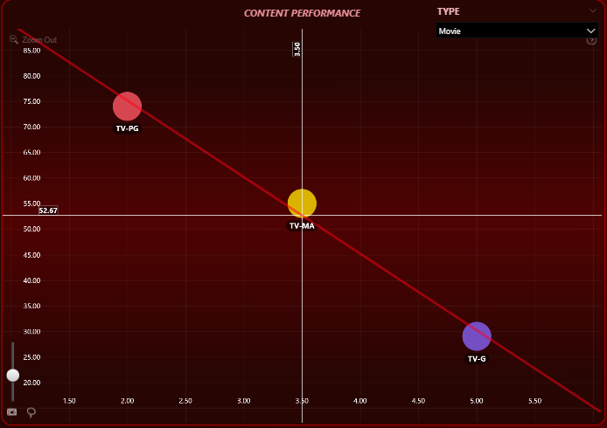
Target Segment is
Love Bloom Teen (Male)
Target Segment is
Heart Stream Youth (Male)
Target Segment is
Love Bloom Teen (Male)
RECOMMENDATION
1. Prioritize PG-13 rated content — it resonates well with this audience, even with lower engagement
2. Reduce promotion of PG-rated movies, as they fail to meet satisfaction levels
3. Explore TV-14 content through curated collections or themed playlists to grow engagement and ratings together
4. Avoid forcing engagement-heavy content that doesn’t align with quality expectations
RECOMMENDATION
1. Continue promoting TV-Y7, TV-G, and TV-MA — they drive both engagement and high customer ratings.
2. Gradually push TV-14 using smart recommendations, trending badges, and youth-focused promotions to unlock its growth potential.
3. Avoid overpromoting any content off the regression line to maintain trust and satisfaction in algorithmic recommendations.
RECOMMENDATION
1. Prioritize PG-13 rated content — it resonates well with this audience, even with lower engagement
2. Reduce promotion of PG-rated movies, as they fail to meet satisfaction levels
3. Explore TV-14 content through curated collections or themed playlists to grow engagement and ratings together
4. Avoid forcing engagement-heavy content that doesn’t align with quality expectations
Target Segment is
Love Bloom Teen (Female)
4
Movies
TV Show
Why?
1. TV-G → High rating and engagement ✅ → Indicates strong emotional connection and high satisfaction.
2. TV-MA → Moderate rating and engagement ➖ → Viewers accept this content, but it’s not a top preference.
3. TV-PG → High engagement but low rating ❌ → Viewers are watching, but they’re not satisfied — leads to dissatisfaction and poor perception of recommendations.
Japan
ENGAGEMENT VS RATING TREND:
Love Bloom Teen (Female) – Japan Trend: Negative slope → Viewers give high ratings for quality content, not based on engagement Fit Quality:
R² = 0.99
Adjusted R² = 0.98 → Extremely strong and reliable trend
Insight on Key Content:
TV-G, TV-MA, and TV-PG appear on the regression line
TV-G: High rating → Strong interest and clear preference
TV-MA: Moderate rating and engagement → Stable performer
TV-PG: High engagement but low rating → Poor reception
AUDIENCE BEHAVIOR ANALYSIS:-
This segment prefers emotional, quality-driven content over popularity or watch time.
TV-G rated movies are highly satisfying → Clear alignment with expectations
TV-MA is accepted moderately → Safe to keep in mix
TV-PG receives poor ratings despite engagement → Misaligned with viewer taste
RECOMMENDATION
1. Prioritize PG-13 rated content — it resonates well with this audience, even with lower engagement
2. Reduce promotion of PG-rated movies, as they fail to meet satisfaction levels
3. Explore TV-14 content through curated collections or themed playlists to grow engagement and ratings together
4. Avoid forcing engagement-heavy content that doesn’t align with quality expectations
RECOMMENDATION
1. Continue promoting TV-Y7, TV-G, and TV-MA — they drive both engagement and high customer ratings.
2. Gradually push TV-14 using smart recommendations, trending badges, and youth-focused promotions to unlock its growth potential.
3. Avoid overpromoting any content off the regression line to maintain trust and satisfaction in algorithmic recommendations.
RECOMMENDATION
1. Promote TV-G content actively through feel-good themed banners, emotional tags, and family-friendly carousels.
2. Retain moderate visibility for TV-MA with proper genre filters (e.g., drama, suspense) to target only interested users.
3. Stop recommending TV-PG content to this segment — it drives engagement but not satisfaction, which can reduce trust in the recommendation system.

Slide 29
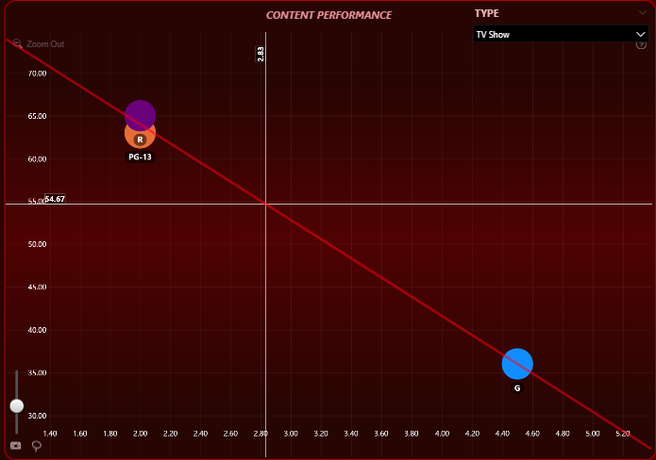
Target Segment is
Love Bloom Teen (Female)
4
Movies
TV Show
Japan
RECOMMENDATION
1. Promote TV-G content actively through feel-good themed banners, emotional tags, and family-friendly carousels.
2. Retain moderate visibility for TV-MA with proper genre filters (e.g., drama, suspense) to target only interested users.
3. Stop recommending TV-PG content to this segment — it drives engagement but not satisfaction, which can reduce trust in the recommendation system.
Why?
1. TV-G → High rating and engagement ✅ → Indicates strong emotional connection and high satisfaction.
2. TV-MA → Moderate rating and engagement ➖ → Viewers accept this content, but it’s not a top preference.
3. TV-PG → High engagement but low rating ❌ → Viewers are watching, but they’re not satisfied — leads to dissatisfaction and poor perception of recommendations.
Target Segment is
Mind Scope Youth (Male)
Why?
1. G-rated → Low engagement, high satisfaction ✅ → Indicates a niche but trusted content type
2. PG-13 & R-rated → High engagement, low rating ❌ → Viewers are watching but leaving disappointed, harming overall perception
ENGAGEMENT VS RATING TREND:
Love Bloom Teen (Female) – Japan Trend: Negative slope → Viewers give high ratings for quality content, not based on engagement Fit Quality:
R² = 0.99
Adjusted R² = 0.98 → Extremely strong and reliable trend
Insight on Key Content:
TV-G, TV-MA, and TV-PG appear on the regression line
TV-G: High rating → Strong interest and clear preference
TV-MA: Moderate rating and engagement → Stable performer
TV-PG: High engagement but low rating → Poor reception
ENGAGEMENT VS RATING TREND:
Trend: Negative slope → Customers give high ratings for good content, not based on engagement Fit Quality:
R² = 0.99, Adjusted R² = 0.99 → Extremely strong and reliable model fit
Insight on Key Content:
G, PG-13, R rated shows lie on the regression line
G: Low engagement, high rating → Strong preference
PG-13 & R: High engagement, low rating → Poor satisfaction
AUDIENCE BEHAVIOR ANALYSIS:-
This segment prefers emotional, quality-driven content over popularity or watch time.
TV-G rated movies are highly satisfying → Clear alignment with expectations
TV-MA is accepted moderately → Safe to keep in mix
TV-PG receives poor ratings despite engagement → Misaligned with viewer taste
AUDIENCE BEHAVIOR ANALYSIS:-
This segment focuses on content quality, not popularity or viewing volume.
G-rated shows are appreciated and deliver strong satisfaction
PG-13 and R-rated content attract engagement but fail to meet expectations
Promoting the wrong content may lead to dissatisfaction despite high views

Slide 30
Target Segment is
Love Bloom Teen (Female)
RECOMMENDATION
1. Promote TV-G content actively through feel-good themed banners, emotional tags, and family-friendly carousels.
2. Retain moderate visibility for TV-MA with proper genre filters (e.g., drama, suspense) to target only interested users.
3. Stop recommending TV-PG content to this segment — it drives engagement but not satisfaction, which can reduce trust in the recommendation system.
Target Segment is
Mind Scope Youth (Male)
4
Movies
TV Show
Why?
1. G-rated → Low engagement, high satisfaction ✅ → Indicates a niche but trusted content type
2. PG-13 & R-rated → High engagement, low rating ❌ → Viewers are watching but leaving disappointed, harming overall perception
Japan
ENGAGEMENT VS RATING TREND:
Trend: Negative slope → Customers give high ratings for good content, not based on engagement Fit Quality:
R² = 0.99, Adjusted R² = 0.99 → Extremely strong and reliable model fit
Insight on Key Content:
G, PG-13, R rated shows lie on the regression line
G: Low engagement, high rating → Strong preference
PG-13 & R: High engagement, low rating → Poor satisfaction
AUDIENCE BEHAVIOR ANALYSIS:-
This segment focuses on content quality, not popularity or viewing volume.
G-rated shows are appreciated and deliver strong satisfaction
PG-13 and R-rated content attract engagement but fail to meet expectations
Promoting the wrong content may lead to dissatisfaction despite high views
RECOMMENDATION
1. Promote G-rated TV shows via calm, emotionally soothing, or feel-good themes
2. Stop recommending PG-13 and R-rated content — engagement is misleading; these fail to meet viewer satisfaction
3. Focus recommendation logic on rating-aligned behavior instead of just watch-time for this segment
.

Slide 31
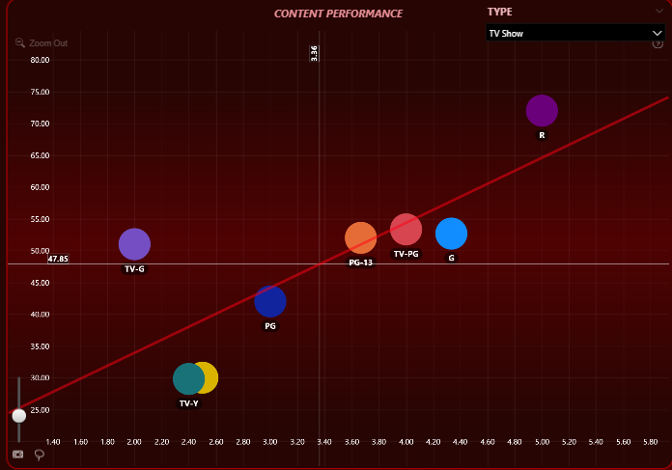
Why?
1. G-rated → Low engagement, high satisfaction ✅ → Indicates a niche but trusted content type
2. PG-13 & R-rated → High engagement, low rating ❌ → Viewers are watching but leaving disappointed, harming overall perception
ENGAGEMENT VS RATING TREND:
Trend: Negative slope → Customers give high ratings for good content, not based on engagement Fit Quality:
R² = 0.99, Adjusted R² = 0.99 → Extremely strong and reliable model fit
Insight on Key Content:
G, PG-13, R rated shows lie on the regression line
G: Low engagement, high rating → Strong preference
PG-13 & R: High engagement, low rating → Poor satisfaction
AUDIENCE BEHAVIOR ANALYSIS:-
This segment focuses on content quality, not popularity or viewing volume.
G-rated shows are appreciated and deliver strong satisfaction
PG-13 and R-rated content attract engagement but fail to meet expectations
Promoting the wrong content may lead to dissatisfaction despite high views
Target Segment is
Mind Scope Youth (Male)
4
Movies
TV Show
Japan
RECOMMENDATION
1. Promote G-rated TV shows via calm, emotionally soothing, or feel-good themes
2. Stop recommending PG-13 and R-rated content — engagement is misleading; these fail to meet viewer satisfaction
3. Focus recommendation logic on rating-aligned behavior instead of just watch-time for this segment
.
Target Segment is
Romance Core Adult (Female)
Why?
1. R-rated → High engagement, high rating ✅ → Strong preference for mature and emotionally engaging themes
2. PG-13, TV-PG, G → Mid-range performance ➖ → Stable choices that support engagement and satisfaction
3. PG-rated → Low on both metrics but aligned with pattern ➕ → Can improve with better positioning and targeting
ENGAGEMENT VS RATING TREND:
Romance Core Adult (Female) – Japan | TV Shows Trend: Positive slope → Higher engagement leads to higher customer ratings Fit Quality: R² = 0.6, Adjusted R² = 0.5 → Moderate but valid trend
Insight on Key Content:
R-rated TV shows: Near the regression line → High engagement and high rating ✅
PG-13, TV-PG, G: Moderate engagement and rating → Aligned with trend
PG: Low engagement and rating, but on the trend line → Potential for growth
AUDIENCE BEHAVIOR ANALYSIS:-
This segment shows a behavioral link between engagement and satisfaction.
R-rated content performs best → Deeply engaging and satisfying
PG-13, TV-PG, G shows are moderately accepted
PG-rated shows underperform currently but follow the trend direction → Room to improve

Slide 32
Target Segment is
Romance Core Adult (Female)
4
Movies
TV Show
Why?
1. R-rated → High engagement, high rating ✅ → Strong preference for mature and emotionally engaging themes
2. PG-13, TV-PG, G → Mid-range performance ➖ → Stable choices that support engagement and satisfaction
3. PG-rated → Low on both metrics but aligned with pattern ➕ → Can improve with better positioning and targeting
Japan
ENGAGEMENT VS RATING TREND:
Romance Core Adult (Female) – Japan | TV Shows Trend: Positive slope → Higher engagement leads to higher customer ratings Fit Quality: R² = 0.6, Adjusted R² = 0.5 → Moderate but valid trend
Insight on Key Content:
R-rated TV shows: Near the regression line → High engagement and high rating ✅
PG-13, TV-PG, G: Moderate engagement and rating → Aligned with trend
PG: Low engagement and rating, but on the trend line → Potential for growth
AUDIENCE BEHAVIOR ANALYSIS:-
This segment shows a behavioral link between engagement and satisfaction.
R-rated content performs best → Deeply engaging and satisfying
PG-13, TV-PG, G shows are moderately accepted
PG-rated shows underperform currently but follow the trend direction → Room to improve

Slide 33
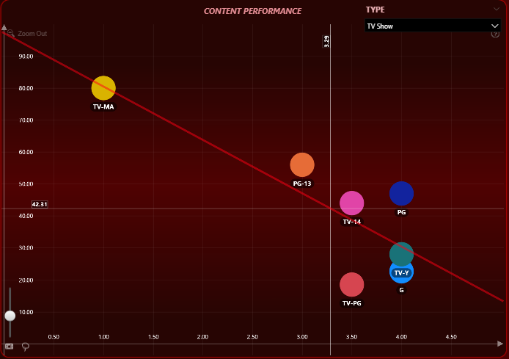
Why?
1. R-rated → High engagement, high rating ✅ → Strong preference for mature and emotionally engaging themes
2. PG-13, TV-PG, G → Mid-range performance ➖ → Stable choices that support engagement and satisfaction
3. PG-rated → Low on both metrics but aligned with pattern ➕ → Can improve with better positioning and targeting
ENGAGEMENT VS RATING TREND:
Romance Core Adult (Female) – Japan | TV Shows Trend: Positive slope → Higher engagement leads to higher customer ratings Fit Quality: R² = 0.6, Adjusted R² = 0.5 → Moderate but valid trend
Insight on Key Content:
R-rated TV shows: Near the regression line → High engagement and high rating ✅
PG-13, TV-PG, G: Moderate engagement and rating → Aligned with trend
PG: Low engagement and rating, but on the trend line → Potential for growth
AUDIENCE BEHAVIOR ANALYSIS:-
This segment shows a behavioral link between engagement and satisfaction.
R-rated content performs best → Deeply engaging and satisfying
PG-13, TV-PG, G shows are moderately accepted
PG-rated shows underperform currently but follow the trend direction → Room to improve
Target Segment is
Romance Core Adult (Female)
4
Movies
TV Show
Japan
RECOMMENDATION
1. Actively promote R-rated TV shows using emotional, romantic, or dramatic themes
2. Maintain presence of PG-13, TV-PG, and G-rated shows as secondary options
3. Test and gradually promote PG-rated content via new thumbnails, storylines, or curated playlists to boost visibility and test for uplift
4. Refine recommendation algorithms to prioritize emotionally engaging content for this segment
Target Segment is
Laugh Legacy (Female)
Why?
1. TV-Y & G → High ratings ✅ → Content makes viewers feel positive and comfortable
2. PG-13 & TV-14 → Mid-level performance ➖ → Acceptable for variety, but not standout
3. TV-MA → High engagement, low rating ❌ → Viewers likely feel misled or uncomfortable with the content tone
ENGAGEMENT VS RATING TREND:
Laugh Legacy (Female) – Japan | TV Shows Trend: Negative slope → Viewers give high ratings for quality content, not based on engagement Fit Quality: R² = 0.69, Adjusted R² = 0.63 → Moderately strong and reliable model fit
Insight on Key Content:
TV-Y, G: High rating → Strong emotional connection despite low engagement
PG-13, TV-14: Moderate rating and engagement → Stable performers
TV-MA: High engagement, low rating → Poor satisfaction
AUDIENCE BEHAVIOR ANALYSIS:-
This segment values feel-good and light-hearted content.
TV-Y & G rated TV shows provide high satisfaction → Well-matched to segment taste
PG-13 & TV-14 are acceptable, offering moderate engagement and rating
TV-MA is not preferred → Despite high engagement, it fails to satisfy

Slide 34
Target Segment is
Romance Core Adult (Female)
RECOMMENDATION
1. Actively promote R-rated TV shows using emotional, romantic, or dramatic themes
2. Maintain presence of PG-13, TV-PG, and G-rated shows as secondary options
3. Test and gradually promote PG-rated content via new thumbnails, storylines, or curated playlists to boost visibility and test for uplift
4. Refine recommendation algorithms to prioritize emotionally engaging content for this segment
Target Segment is
Laugh Legacy (Female)
4
Movies
TV Show
Why?
1. TV-Y & G → High ratings ✅ → Content makes viewers feel positive and comfortable
2. PG-13 & TV-14 → Mid-level performance ➖ → Acceptable for variety, but not standout
3. TV-MA → High engagement, low rating ❌ → Viewers likely feel misled or uncomfortable with the content tone
Japan
ENGAGEMENT VS RATING TREND:
Laugh Legacy (Female) – Japan | TV Shows Trend: Negative slope → Viewers give high ratings for quality content, not based on engagement Fit Quality: R² = 0.69, Adjusted R² = 0.63 → Moderately strong and reliable model fit
Insight on Key Content:
TV-Y, G: High rating → Strong emotional connection despite low engagement
PG-13, TV-14: Moderate rating and engagement → Stable performers
TV-MA: High engagement, low rating → Poor satisfaction
AUDIENCE BEHAVIOR ANALYSIS:-
This segment values feel-good and light-hearted content.
TV-Y & G rated TV shows provide high satisfaction → Well-matched to segment taste
PG-13 & TV-14 are acceptable, offering moderate engagement and rating
TV-MA is not preferred → Despite high engagement, it fails to satisfy
RECOMMENDATION
1. Promote TV-Y and G-rated TV shows using cheerful visuals and upbeat content themes
2. Keep PG-13 and TV-14 in rotation as neutral support content
3. Avoid recommending TV-MA rated shows — these do not align with viewer preferences and may reduce trust in platform suggestions

Slide 35
Why?
1. TV-Y & G → High ratings ✅ → Content makes viewers feel positive and comfortable
2. PG-13 & TV-14 → Mid-level performance ➖ → Acceptable for variety, but not standout
3. TV-MA → High engagement, low rating ❌ → Viewers likely feel misled or uncomfortable with the content tone
ENGAGEMENT VS RATING TREND:
Laugh Legacy (Female) – Japan | TV Shows Trend: Negative slope → Viewers give high ratings for quality content, not based on engagement Fit Quality: R² = 0.69, Adjusted R² = 0.63 → Moderately strong and reliable model fit
Insight on Key Content:
TV-Y, G: High rating → Strong emotional connection despite low engagement
PG-13, TV-14: Moderate rating and engagement → Stable performers
TV-MA: High engagement, low rating → Poor satisfaction
AUDIENCE BEHAVIOR ANALYSIS:-
This segment values feel-good and light-hearted content.
TV-Y & G rated TV shows provide high satisfaction → Well-matched to segment taste
PG-13 & TV-14 are acceptable, offering moderate engagement and rating
TV-MA is not preferred → Despite high engagement, it fails to satisfy
Target Segment is
Laugh Legacy (Female)
4
Movies
TV Show
Japan
RECOMMENDATION
1. Promote TV-Y and G-rated TV shows using cheerful visuals and upbeat content themes
2. Keep PG-13 and TV-14 in rotation as neutral support content
3. Avoid recommending TV-MA rated shows — these do not align with viewer preferences and may reduce trust in platform suggestions

Slide 36
1

Slide 37
1
Basic
Standard
Premium
Subscription and Engagement Insights
BASIC SUBSCRIPTION USER INSIGHTS SUMMARY
📊 User Demographics
Total Viewers:
Male: 1530
Female: 1560
Others: 1540
Fairly balanced engagement across genders, with a slight female majority.
🌍 Geographic Distribution
Highest viewers are from:
Europe (1200+ viewers)
Asia (1300+ viewers)
Followed by North America and Oceania🔁
Viewer Type
Repeated Viewers: 1930
One-time Viewers: 604
→ Suggests good content retention for Basic users.
🎭 Top Genre Engagement
Overall Top Genre: Sci-Fi
Overall Low Genre: Horror
Weekday Trend: Romance is preferred
Weekend Trend: Sci-Fi is preferred
📅 Time-based Behavior
Weekday Viewership: 72.01%
Weekend Viewership: 27.99%
→ Heavy weekday consumption; likely driven by flexible schedules or binge patterns.
🎬 Content Type Preference
Movies: 51.75%
TV Shows: 48.25%
→ Slight movie preference; ensure balance in both formats.
🧠 Engagement Segmentation (Top 5 Segments)
Thriller Core Adult,
Legacy Thriller,
Sci-Mystic Adult,
Comedy Core Adult,
Romance Core Adult
📊 User Demographics
Total Viewers:
Male: 1641
Female: 1587
Others: 1580
Fairly balanced engagement across genders, with a slight Male majority.
🌍 Geographic Distribution
Highest viewers are from:
Europe (1300+ viewers)
Asia (1400+ viewers)
Followed by North America and Oceania🔁
Viewer Type
Repeated Viewers: 2K
One-time Viewers: 641
→ Suggests good content retention for Standard users.
🎭 Top Genre Engagement
Overall Top Genre: Sci-Fi
Overall Low Genre: Comdey
Weekday Trend: Fantasy is preferred
Weekend Trend: Sci-Fi is preferred
📅 Time-based Behavior
Weekday Viewership: 71.77%
Weekend Viewership: 28.23%
→ Heavy weekday consumption; likely driven by flexible schedules or binge patterns.
🎬 Content Type Preference
Movies: 50.44%
TV Shows: 49.56%
→ Slight movie preference; ensure balance in both formats.
🧠 Engagement Segmentation (Top 5 Segments)
Thriller Core Adult,
Sci-Mystic Adult,
Legacy Thriller,
Romance Core Adult
Comedy Core Adult,

Slide 38
1
Basic
Standard
Premium
Subscription and Engagement Insights
STANDARD SUBSCRIPTION USER INSIGHTS SUMMARY
📊 User Demographics
Total Viewers:
Male: 1530
Female: 1560
Others: 1540
Fairly balanced engagement across genders, with a slight female majority.
🌍 Geographic Distribution
Highest viewers are from:
Europe (1200+ viewers)
Asia (1300+ viewers)
Followed by North America and Oceania🔁
Viewer Type
Repeated Viewers: 1930
One-time Viewers: 604
→ Suggests good content retention for Basic users.
🎭 Top Genre Engagement
Overall Top Genre: Sci-Fi
Overall Low Genre: Horror
Weekday Trend: Romance is preferred
Weekend Trend: Sci-Fi is preferred
📅 Time-based Behavior
Weekday Viewership: 72.01%
Weekend Viewership: 27.99%
→ Heavy weekday consumption; likely driven by flexible schedules or binge patterns.
🎬 Content Type Preference
Movies: 51.75%
TV Shows: 48.25%
→ Slight movie preference; ensure balance in both formats.
🧠 Engagement Segmentation (Top 5 Segments)
Thriller Core Adult,
Legacy Thriller,
Sci-Mystic Adult,
Comedy Core Adult,
Romance Core Adult
📊 User Demographics
Total Viewers:
Male: 1641
Female: 1587
Others: 1580
Fairly balanced engagement across genders, with a slight Male majority.
🌍 Geographic Distribution
Highest viewers are from:
Europe (1300+ viewers)
Asia (1400+ viewers)
Followed by North America and Oceania🔁
Viewer Type
Repeated Viewers: 2K
One-time Viewers: 641
→ Suggests good content retention for Standard users.
🎭 Top Genre Engagement
Overall Top Genre: Sci-Fi
Overall Low Genre: Comdey
Weekday Trend: Fantasy is preferred
Weekend Trend: Sci-Fi is preferred
📅 Time-based Behavior
Weekday Viewership: 71.77%
Weekend Viewership: 28.23%
→ Heavy weekday consumption; likely driven by flexible schedules or binge patterns.
🎬 Content Type Preference
Movies: 50.44%
TV Shows: 49.56%
→ Slight movie preference; ensure balance in both formats.
🧠 Engagement Segmentation (Top 5 Segments)
Thriller Core Adult,
Sci-Mystic Adult,
Legacy Thriller,
Romance Core Adult
Comedy Core Adult,
📊 User Demographics
Total Viewers:
Male: 1532
Female: 1597
Others: 1492
Fairly balanced engagement across genders, with a slight Female majority.
🌍 Geographic Distribution
Highest viewers are from:
Europe (1400+ viewers)
Asia (1460+ viewers)
Followed by North America and Oceania🔁
Viewer Type
Repeated Viewers: 1.86K
One-time Viewers: 657
→ Suggests good content retention for Standard users.
🎭 Top Genre Engagement
Overall Top Genre: Horror
Overall Low Genre: Comdey
Weekday Trend: Horror is preferred
Weekend Trend: Romance is preferred
📅 Time-based Behavior
Weekday Viewership: 70.62%
Weekend Viewership: 29.38%
→ Heavy weekday consumption; likely driven by flexible schedules or binge patterns.
🎬 Content Type Preference
Movies: 50.72%
TV Shows: 49.28%
→ Slight movie preference; ensure balance in both formats.
🧠 Engagement Segmentation (Top 5 Segments)
Thriller Core Adult,
Legacy Thriller,
Romance Core Adult,
Comedy Core Adult,
Sci-Mystic Adult

Slide 39
1
Basic
Standard
Premium
Subscription and Engagement Insights
PREMIUM SUBSCRIPTION USER INSIGHTS SUMMARY
📊 User Demographics
Total Viewers:
Male: 1530
Female: 1560
Others: 1540
Fairly balanced engagement across genders, with a slight female majority.
🌍 Geographic Distribution
Highest viewers are from:
Europe (386 viewers)
Asia (263 viewers)
Followed by North America and Oceania🔁
Viewer Type
Repeated Viewers: 1930
One-time Viewers: 604
→ Suggests good content retention for Basic users.
🎭 Top Genre Engagement
Overall Top Genre: Sci-Fi
Overall Low Genre: Horror
Weekday Trend: Romance is preferred
Weekend Trend: Sci-Fi is preferred
📅 Time-based Behavior
Weekday Viewership: 72.01%
Weekend Viewership: 27.99%
→ Heavy weekday consumption; likely driven by flexible schedules or binge patterns.
🎬 Content Type Preference
Movies: 51.75%
TV Shows: 48.25%
→ Slight movie preference; ensure balance in both formats.
🧠 Engagement Segmentation (Top 5 Segments)
Thriller Core Adult,
Legacy Thriller,
Sci-Mystic Adult,
Comedy Core Adult,
Romance Core Adult
📊 User Demographics
Total Viewers:
Male: 1641
Female: 1587
Others: 1580
Fairly balanced engagement across genders, with a slight Male majority.
🌍 Geographic Distribution
Highest viewers are from:
Europe (1300+ viewers)
Asia (1400+ viewers)
Followed by North America and Oceania🔁
Viewer Type
Repeated Viewers: 2K
One-time Viewers: 641
→ Suggests good content retention for Standard users.
🎭 Top Genre Engagement
Overall Top Genre: Sci-Fi
Overall Low Genre: Comdey
Weekday Trend: Fantasy is preferred
Weekend Trend: Sci-Fi is preferred
📅 Time-based Behavior
Weekday Viewership: 71.77%
Weekend Viewership: 28.23%
→ Heavy weekday consumption; likely driven by flexible schedules or binge patterns.
🎬 Content Type Preference
Movies: 50.44%
TV Shows: 49.56%
→ Slight movie preference; ensure balance in both formats.
🧠 Engagement Segmentation (Top 5 Segments)
Thriller Core Adult,
Sci-Mystic Adult,
Legacy Thriller,
Romance Core Adult
Comedy Core Adult,
📊 User Demographics
Total Viewers:
Male: 1532
Female: 1597
Others: 1492
Fairly balanced engagement across genders, with a slight Female majority.
🌍 Geographic Distribution
Highest viewers are from:
Europe (1400+ viewers)
Asia (1460+ viewers)
Followed by North America and Oceania🔁
Viewer Type
Repeated Viewers: 1.86K
One-time Viewers: 657
→ Suggests good content retention for Standard users.
🎭 Top Genre Engagement
Overall Top Genre: Horror
Overall Low Genre: Comdey
Weekday Trend: Horror is preferred
Weekend Trend: Romance is preferred
📅 Time-based Behavior
Weekday Viewership: 70.62%
Weekend Viewership: 29.38%
→ Heavy weekday consumption; likely driven by flexible schedules or binge patterns.
🎬 Content Type Preference
Movies: 50.72%
TV Shows: 49.28%
→ Slight movie preference; ensure balance in both formats.
🧠 Engagement Segmentation (Top 5 Segments)
Thriller Core Adult,
Legacy Thriller,
Romance Core Adult,
Comedy Core Adult,
Sci-Mystic Adult

Slide 40
2

Slide 41
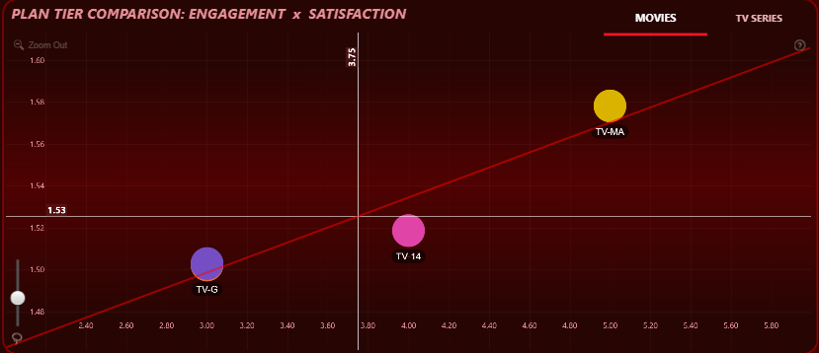
Target Segment is
Dream Code Teen (Male)
2
Movies
TV Show
Basic Subscription
ENGAGEMENT VS RATING TREND:
Dream Code Teen (Male) – France | Movies Trend: Positive slope → Longer movies result in higher customer ratings Fit Quality: R² = 0.91, Adjusted R² = 0.86 → Strong and highly reliable trend
Insight on Key Content:
TV-MA, TV-14, TV-G, PG-13 rated movies appear on the regression line
TV-MA: Longest duration & highest rating → Strong preference
TV-14: Moderate duration & rating → Stable performance
TV-G, PG-13: Low duration & rating → Lower satisfaction but follow trend → Potential to improve
Why?
1. TV-Y & G → Low engagement, high satisfaction ✅ → Viewers enjoy these formats even if not frequently watched
2. TV-MA → High engagement, low rating ❌ → Viewers try it but don’t like it, leading to dissatisfaction
3. PG-13 & TV-14 → Middle-ground performers ➖ → Consistent but not strong drivers of loyalty
AUDIENCE BEHAVIOR ANALYSIS:-
This segment prefers light, feel-good content.
TV-Y and G rated shows align well with emotional preferences → Drive satisfaction
PG-13 and TV-14 are acceptable but not standout
TV-MA content creates dissatisfaction despite high watch time → Mismatch with viewer expectations
RECOMMENDATION
1. Focus on recommending TV-Y and G-rated content — align with emotional preferences of the segment
2. Retain PG-13 and TV-14 rated shows with limited visibility as safe choices
3. Stop recommending TV-MA content — leads to disappointment despite high engagement
4.Prioritize light-hearted, family-safe, and emotionally comforting TV shows for this audience

Slide 42
ENGAGEMENT VS RATING TREND:
Dream Code Teen (Male) – France | Movies Trend: Positive slope → Longer movies result in higher customer ratings Fit Quality: R² = 0.91, Adjusted R² = 0.86 → Strong and highly reliable trend
Insight on Key Content:
TV-MA, TV-14, TV-G, PG-13 rated movies appear on the regression line
TV-MA: Longest duration & highest rating → Strong preference
TV-14: Moderate duration & rating → Stable performance
TV-G, PG-13: Low duration & rating → Lower satisfaction but follow trend → Potential to improve
Why?
1. TV-Y & G → Low engagement, high satisfaction ✅ → Viewers enjoy these formats even if not frequently watched
2. TV-MA → High engagement, low rating ❌ → Viewers try it but don’t like it, leading to dissatisfaction
3. PG-13 & TV-14 → Middle-ground performers ➖ → Consistent but not strong drivers of loyalty
AUDIENCE BEHAVIOR ANALYSIS:-
This segment prefers light, feel-good content.
TV-Y and G rated shows align well with emotional preferences → Drive satisfaction
PG-13 and TV-14 are acceptable but not standout
TV-MA content creates dissatisfaction despite high watch time → Mismatch with viewer expectations
Target Segment is
Dream Code Teen (Male)
2
Movies
TV Show
Basic Subscription
RECOMMENDATION
1. Focus on recommending TV-Y and G-rated content — align with emotional preferences of the segment
2. Retain PG-13 and TV-14 rated shows with limited visibility as safe choices
3. Stop recommending TV-MA content — leads to disappointment despite high engagement
4.Prioritize light-hearted, family-safe, and emotionally comforting TV shows for this audience

Slide 43
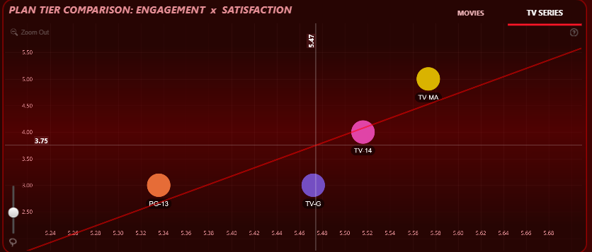
RECOMMENDATION
1. Focus on recommending TV-Y and G-rated content — align with emotional preferences of the segment
2. Retain PG-13 and TV-14 rated shows with limited visibility as safe choices
3. Stop recommending TV-MA content — leads to disappointment despite high engagement
4.Prioritize light-hearted, family-safe, and emotionally comforting TV shows for this audience
Target Segment is
Dream Code Teen (Male)
2
Movies
TV Show
Basic Subscription
ENGAGEMENT VS RATING TREND:
DreamCode_Teen (Male) – France | TV Shows Trend: Positive slope → Higher duration leads to higher customer satisfaction Fit Quality: R² = 0.68, Adjusted R² = 0.52 → Moderate but meaningful trend
Insight on Key Content:
TV-MA, TV-14, PG-13 appear on the regression line
TV-MA: Long duration, high rating ✅ → Preferred for rich content
TV-14: Moderate duration & rating ➖ → Stable content
PG-13: Low duration, low rating ❌ → Content perceived as insufficient but can improve
AUDIENCE BEHAVIOR ANALYSIS:-
This segment prefers TV shows with more depth and screen time.
TV-MA shows are highly satisfying due to richer content and longer episodes
TV-14 performs acceptably but may benefit from slight content enhancement
PG-13 shows underperform due to shorter duration, not necessarily quality
Why?
1. TV-MA → High duration, high rating ✅ → Indicates a demand for complex and extended storylines
2. TV-14 → Balanced ➖ → Acceptable engagement, potential to boost
3. PG-13 → Short duration, low satisfaction ❌ → Needs content enrichment to meet expectations
RECOMMENDATION
1. Focus on recommending TV-Y and G-rated content — align with emotional preferences of the segment
2. Retain PG-13 and TV-14 rated shows with limited visibility as safe choices
3. Stop recommending TV-MA content — leads to disappointment despite high engagement
4.Prioritize light-hearted, family-safe, and emotionally comforting TV shows for this audience
RECOMMENDATION
1. Prioritize TV-MA shows with full-season releases or rich plot arcs
2. Enhance TV-14 shows through mini-arcs, bonus episodes, or deeper themes
3. Revamp PG-13 shows by extending runtime or merging episodes to increase value perception
4. Highlight “binge-worthy” content with 25+ minute episodes to attract this segment

Slide 44
RECOMMENDATION
1. Focus on recommending TV-Y and G-rated content — align with emotional preferences of the segment
2. Retain PG-13 and TV-14 rated shows with limited visibility as safe choices
3. Stop recommending TV-MA content — leads to disappointment despite high engagement
4.Prioritize light-hearted, family-safe, and emotionally comforting TV shows for this audience
ENGAGEMENT VS RATING TREND:
DreamCode_Teen (Male) – France | TV Shows Trend: Positive slope → Higher duration leads to higher customer satisfaction Fit Quality: R² = 0.68, Adjusted R² = 0.52 → Moderate but meaningful trend
Insight on Key Content:
TV-MA, TV-14, PG-13 appear on the regression line
TV-MA: Long duration, high rating ✅ → Preferred for rich content
TV-14: Moderate duration & rating ➖ → Stable content
PG-13: Low duration, low rating ❌ → Content perceived as insufficient but can improve
AUDIENCE BEHAVIOR ANALYSIS:-
This segment prefers TV shows with more depth and screen time.
TV-MA shows are highly satisfying due to richer content and longer episodes
TV-14 performs acceptably but may benefit from slight content enhancement
PG-13 shows underperform due to shorter duration, not necessarily quality
Why?
1. TV-MA → High duration, high rating ✅ → Indicates a demand for complex and extended storylines
2. TV-14 → Balanced ➖ → Acceptable engagement, potential to boost
3. PG-13 → Short duration, low satisfaction ❌ → Needs content enrichment to meet expectations
Target Segment is
Dream Code Teen (Male)
2
Movies
TV Show
Basic Subscription
RECOMMENDATION
1. Prioritize TV-MA shows with full-season releases or rich plot arcs
2. Enhance TV-14 shows through mini-arcs, bonus episodes, or deeper themes
3. Revamp PG-13 shows by extending runtime or merging episodes to increase value perception
4. Highlight “binge-worthy” content with 25+ minute episodes to attract this segment
RECOMMENDATION
1. Focus on recommending TV-Y and G-rated content — align with emotional preferences of the segment
2. Retain PG-13 and TV-14 rated shows with limited visibility as safe choices
3. Stop recommending TV-MA content — leads to disappointment despite high engagement
4.Prioritize light-hearted, family-safe, and emotionally comforting TV shows for this audience

Slide 45
3

Slide 46
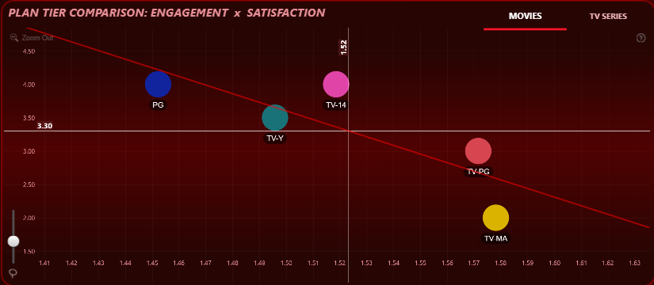
Target Segment is
Heart Stream Youth (Male)
3
Movies
TV Show
Standard Subscription
ENGAGEMENT VS RATING TREND:
HeartStream_Youth (Male) – India | Movies Trend: Negative slope → Shorter movies receive higher customer ratings Fit Quality: R² = 0.6, Adjusted R² = 0.5 → Moderate and reliable trend
Insight on Key Content:
PG, TV-Y, TV-PG appear on the regression line
PG: High rating, low duration ✅ → Strongly preferred
TV-Y: Moderate rating and duration ➖ → Acceptable
TV-PG: Low rating, long duration ❌ → Poor fit for this segment
AUDIENCE BEHAVIOR ANALYSIS:-
This segment prefers short, crisp movie content.
PG-rated movies perform best with high satisfaction in less time
TV-Y is moderately accepted
TV-PG content leads to dissatisfaction due to longer length and lower payoff
Why?
1. PG → Low duration, high rating ✅ → Indicates preference for quick, engaging content
2. TV-Y → Balanced, light-viewing option ➖ → Viewers accept it in limited doses
3. TV-PG → High duration, low satisfaction ❌ → Viewers lose interest or feel it's dragged, leading to dissatisfaction
RECOMMENDATION
1. Promote PG-rated short movies through light, fun, and fast-viewing collections
2. Retain TV-Y movies in minimal visibility as backup options
3. Avoid recommending TV-PG movies — poor alignment with viewer preference may reduce satisfaction
4. Focus on snackable content strategy — short-form, engaging, and easy-to-watch movie experiences for this segment

Slide 47
ENGAGEMENT VS RATING TREND:
HeartStream_Youth (Male) – India | Movies Trend: Negative slope → Shorter movies receive higher customer ratings Fit Quality: R² = 0.6, Adjusted R² = 0.5 → Moderate and reliable trend
Insight on Key Content:
PG, TV-Y, TV-PG appear on the regression line
PG: High rating, low duration ✅ → Strongly preferred
TV-Y: Moderate rating and duration ➖ → Acceptable
TV-PG: Low rating, long duration ❌ → Poor fit for this segment
AUDIENCE BEHAVIOR ANALYSIS:-
This segment prefers short, crisp movie content.
PG-rated movies perform best with high satisfaction in less time
TV-Y is moderately accepted
TV-PG content leads to dissatisfaction due to longer length and lower payoff
Why?
1. PG → Low duration, high rating ✅ → Indicates preference for quick, engaging content
2. TV-Y → Balanced, light-viewing option ➖ → Viewers accept it in limited doses
3. TV-PG → High duration, low satisfaction ❌ → Viewers lose interest or feel it's dragged, leading to dissatisfaction
Target Segment is
Heart Stream Youth (Male)
3
Movies
TV Show
Standard Subscription
RECOMMENDATION
1. Promote PG-rated short movies through light, fun, and fast-viewing collections
2. Retain TV-Y movies in minimal visibility as backup options
3. Avoid recommending TV-PG movies — poor alignment with viewer preference may reduce satisfaction
4. Focus on snackable content strategy — short-form, engaging, and easy-to-watch movie experiences for this segment

Slide 48
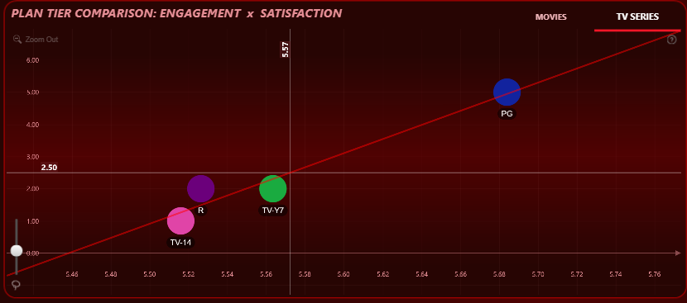
Target Segment is
Dream Code Teen (Male)
3
Movies
TV Show
Standard Subscription
ENGAGEMENT VS RATING TREND:
Dream Code Teen (Male) – India | TV Shows Trend: Positive slope → Longer duration TV shows result in higher customer ratings Fit Quality: R² = 0.95, Adjusted R² = 0.92 → Very strong and highly reliable trend
Insight on Key Content:
PG, TV-Y7, R, TV-14 appear on or near the regression line
PG: High duration, high rating ✅ → Best performer
TV-Y7, R, TV-14: Low duration, low rating ❌ → But follow the trend → Potential to grow
AUDIENCE BEHAVIOR ANALYSIS:-
This segment values long-form, content-rich TV shows.
PG-rated shows are most satisfying due to their depth and runtime
TV-Y7, R, and TV-14 have low satisfaction currently due to shorter content length, not content quality
These formats can perform better if extended
Why?
1. PG → Long duration, high rating ✅ → Clear alignment with segment’s preference for rich content
2. TV-Y7, R, TV-14 → Short duration, low rating ❌ → Shows are underperforming due to content limitations, not viewer disinterest → High potential
RECOMMENDATION
1. Promote PG-rated TV shows as premium, binge-worthy content
2. Expand content length of TV-Y7, R, and TV-14 shows through bonus episodes, director’s cuts, or full-season drops
3. Highlight total watch-time value in carousels (e.g., "Watch 5 episodes in one go") to attract attention
4.Tailor recommendations to emphasize “more content = more satisfaction” for this segment
RECOMMENDATION
1. Promote PG-rated short movies through light, fun, and fast-viewing collections
2. Retain TV-Y movies in minimal visibility as backup options
3. Avoid recommending TV-PG movies — poor alignment with viewer preference may reduce satisfaction
4. Focus on snackable content strategy — short-form, engaging, and easy-to-watch movie experiences for this segment

Slide 49
ENGAGEMENT VS RATING TREND:
Dream Code Teen (Male) – India | TV Shows Trend: Positive slope → Longer duration TV shows result in higher customer ratings Fit Quality: R² = 0.95, Adjusted R² = 0.92 → Very strong and highly reliable trend
Insight on Key Content:
PG, TV-Y7, R, TV-14 appear on or near the regression line
PG: High duration, high rating ✅ → Best performer
TV-Y7, R, TV-14: Low duration, low rating ❌ → But follow the trend → Potential to grow
AUDIENCE BEHAVIOR ANALYSIS:-
This segment values long-form, content-rich TV shows.
PG-rated shows are most satisfying due to their depth and runtime
TV-Y7, R, and TV-14 have low satisfaction currently due to shorter content length, not content quality
These formats can perform better if extended
Why?
1. PG → Long duration, high rating ✅ → Clear alignment with segment’s preference for rich content
2. TV-Y7, R, TV-14 → Short duration, low rating ❌ → Shows are underperforming due to content limitations, not viewer disinterest → High potential
Target Segment is
Dream Code Teen (Male)
3
Movies
TV Show
Standard Subscription
RECOMMENDATION
1. Promote PG-rated TV shows as premium, binge-worthy content
2. Expand content length of TV-Y7, R, and TV-14 shows through bonus episodes, director’s cuts, or full-season drops
3. Highlight total watch-time value in carousels (e.g., "Watch 5 episodes in one go") to attract attention
4.Tailor recommendations to emphasize “more content = more satisfaction” for this segment
RECOMMENDATION
1. Promote PG-rated short movies through light, fun, and fast-viewing collections
2. Retain TV-Y movies in minimal visibility as backup options
3. Avoid recommending TV-PG movies — poor alignment with viewer preference may reduce satisfaction
4. Focus on snackable content strategy — short-form, engaging, and easy-to-watch movie experiences for this segment

